Slide 1
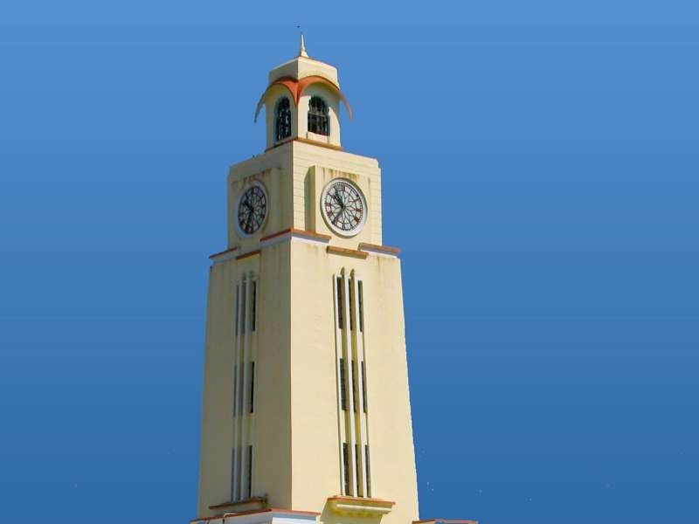

,
Deep Learning Models for Multivariate Time-series Analytics
Supervisor – Dr. Poonam Goyal
Harshit Agrawal
(2018A8PS0484P)
BITS Pilani, Pilani Campus

Slide 2
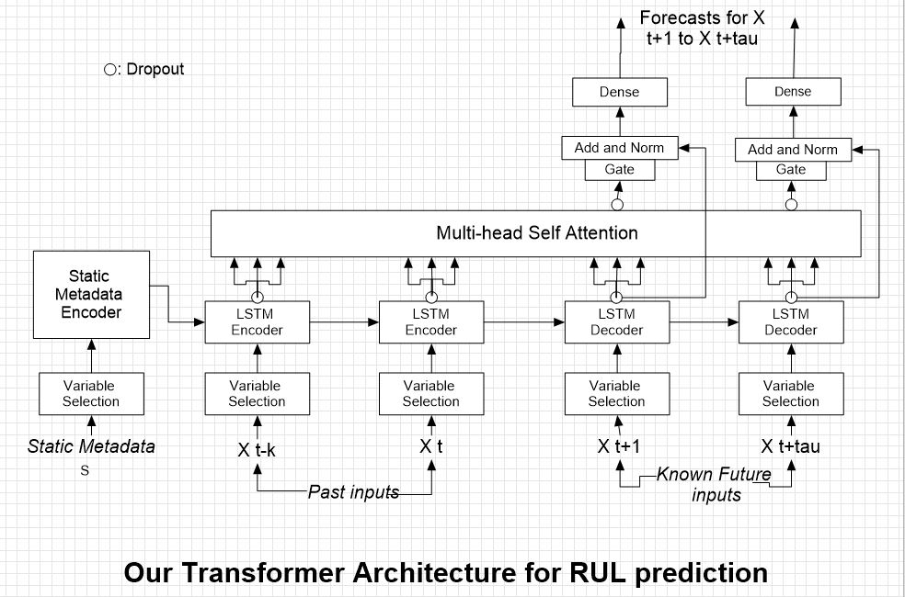
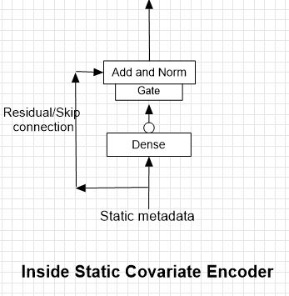

Slide 3
CMAPPS

Slide 4
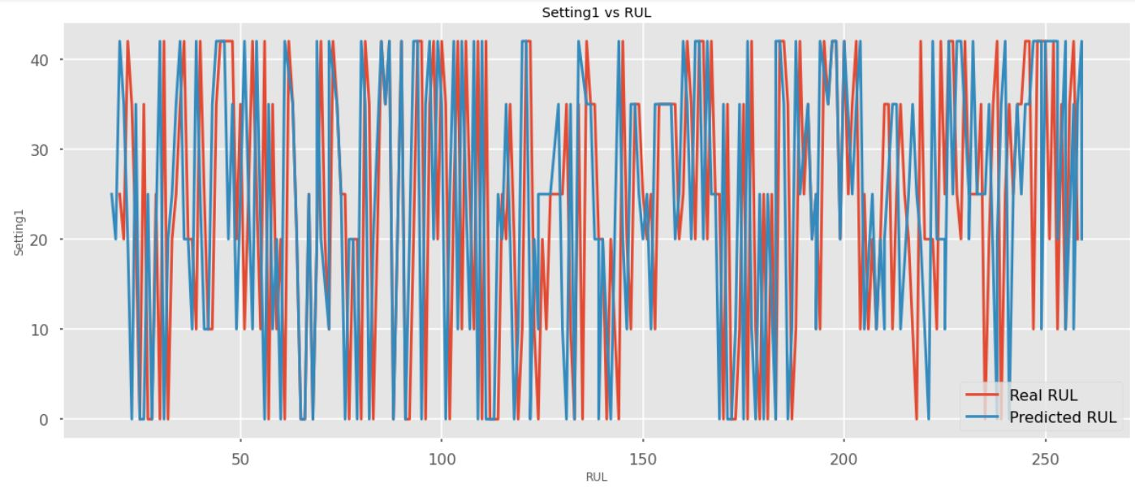

Slide 5
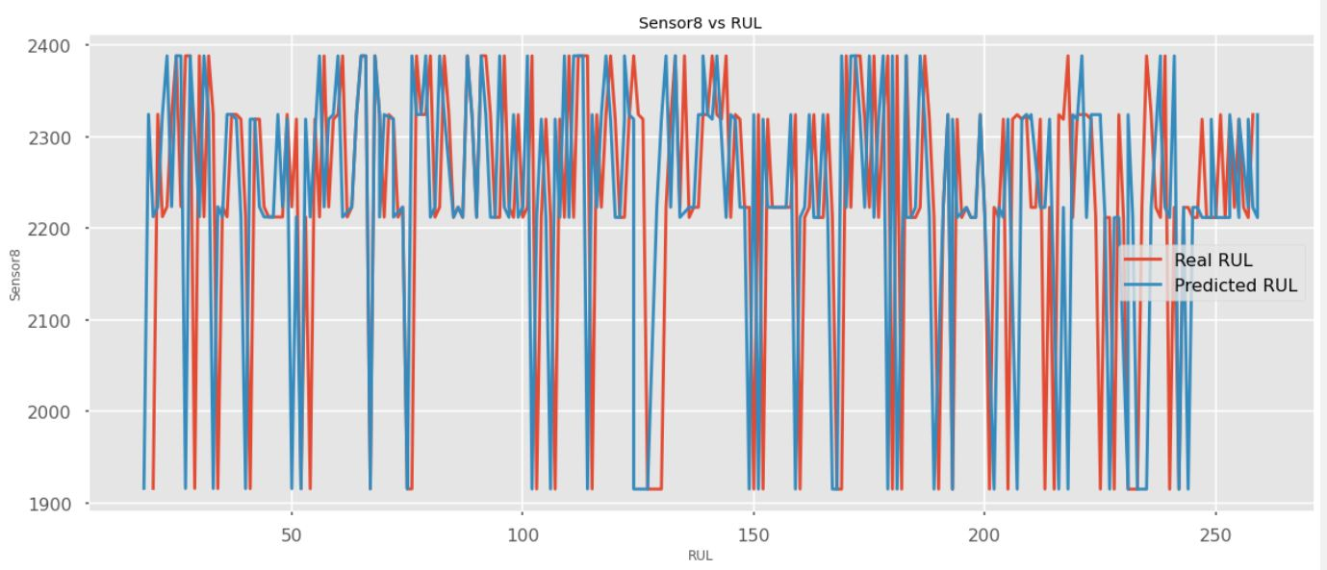

Slide 6
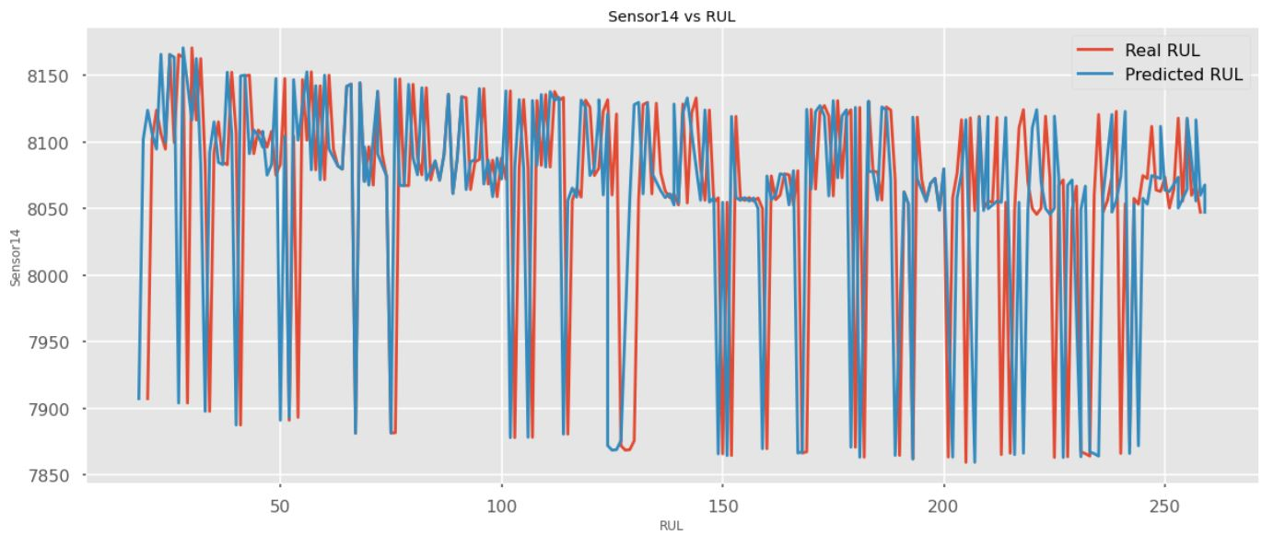

Slide 7
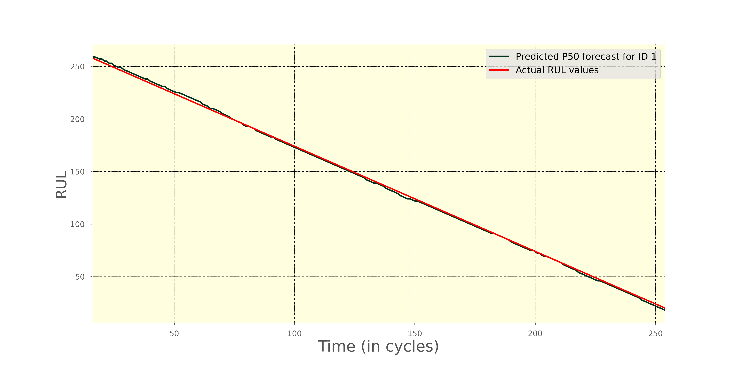

Slide 8
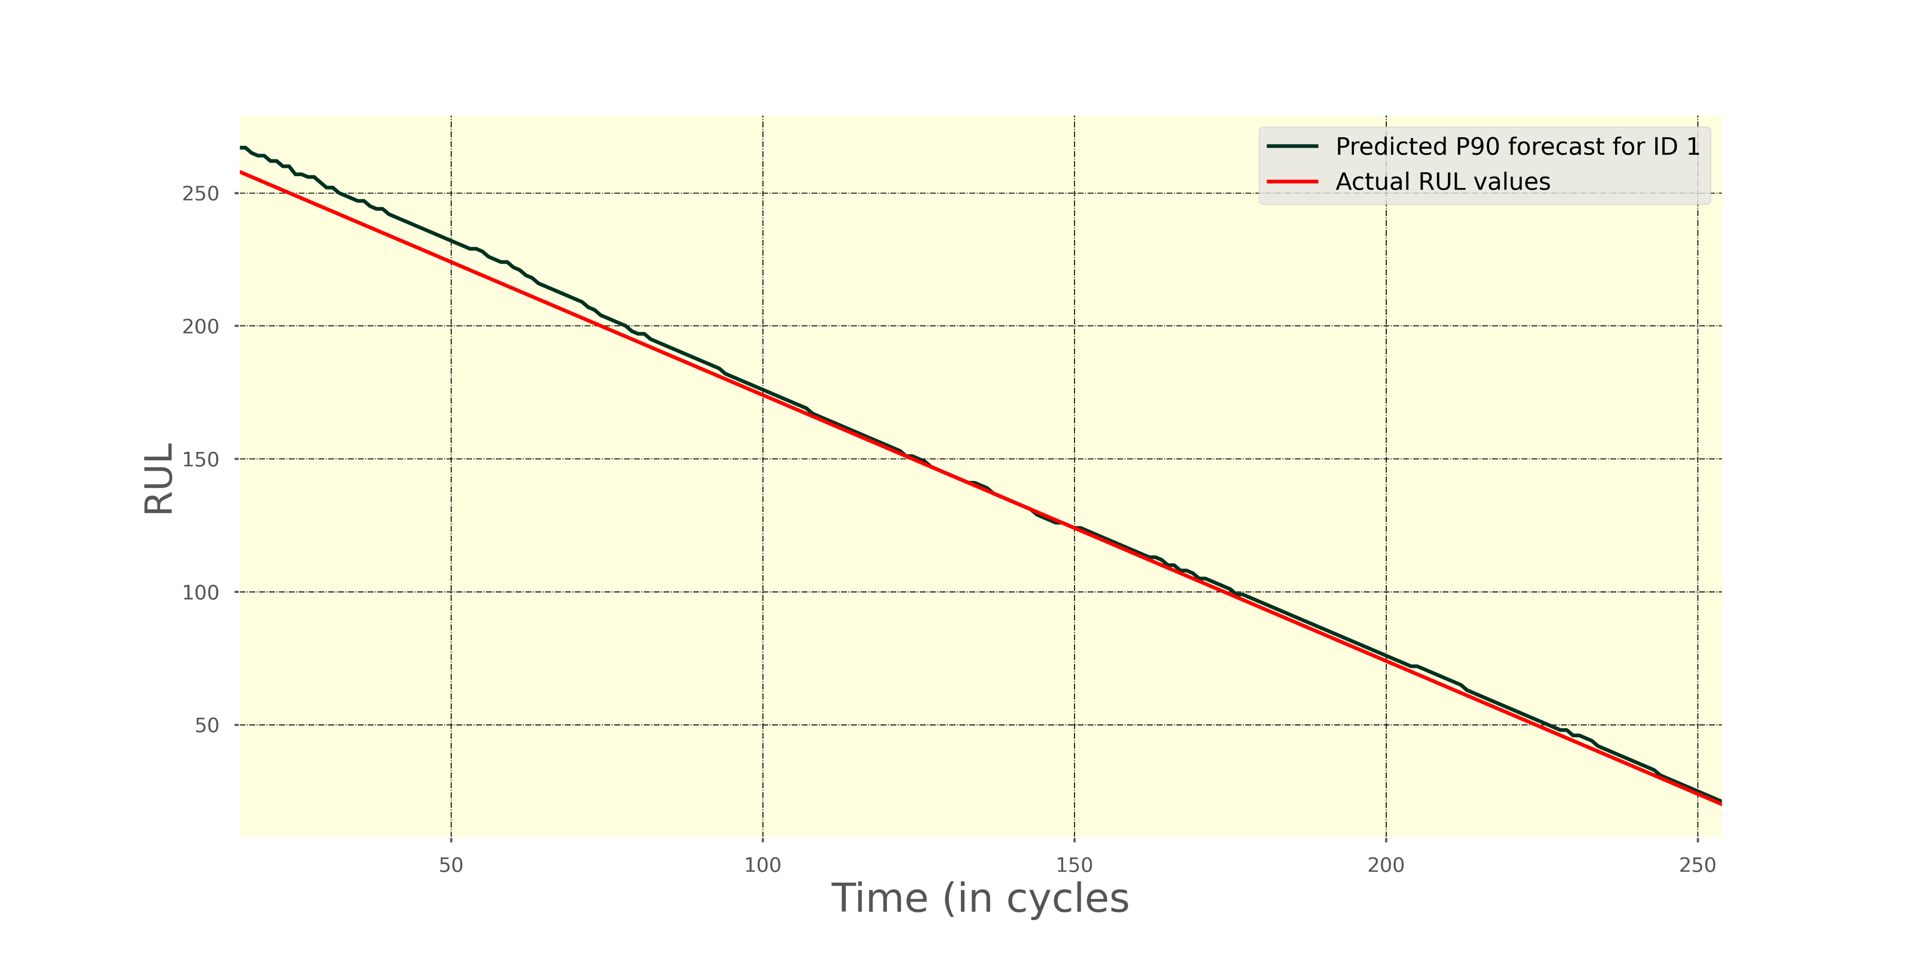

Slide 9
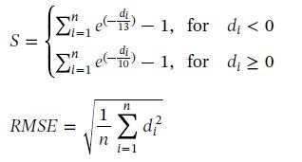

Slide 10
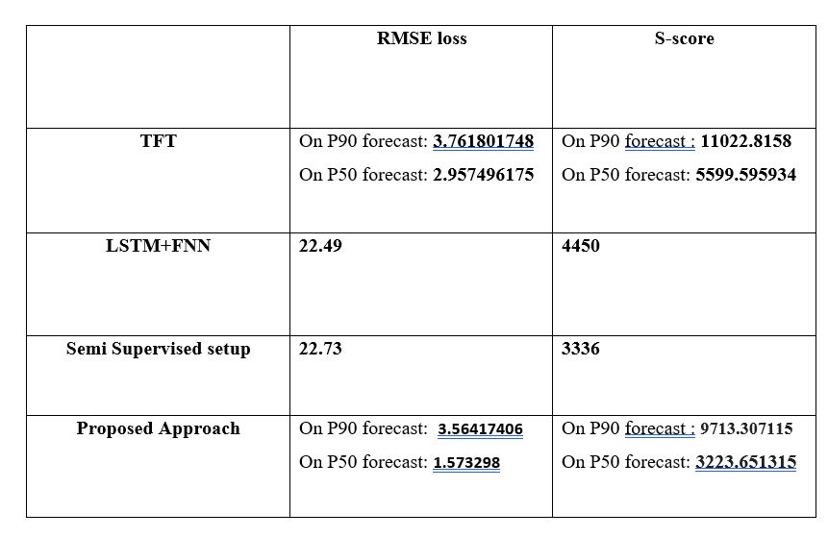

Slide 11
NCMAPPS

Slide 12
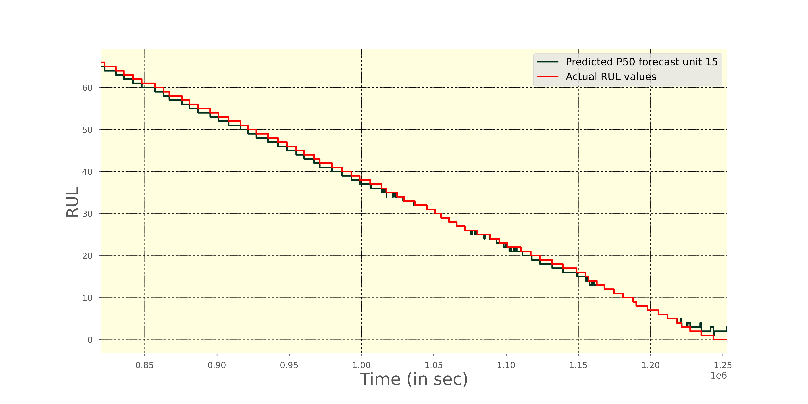

Slide 13
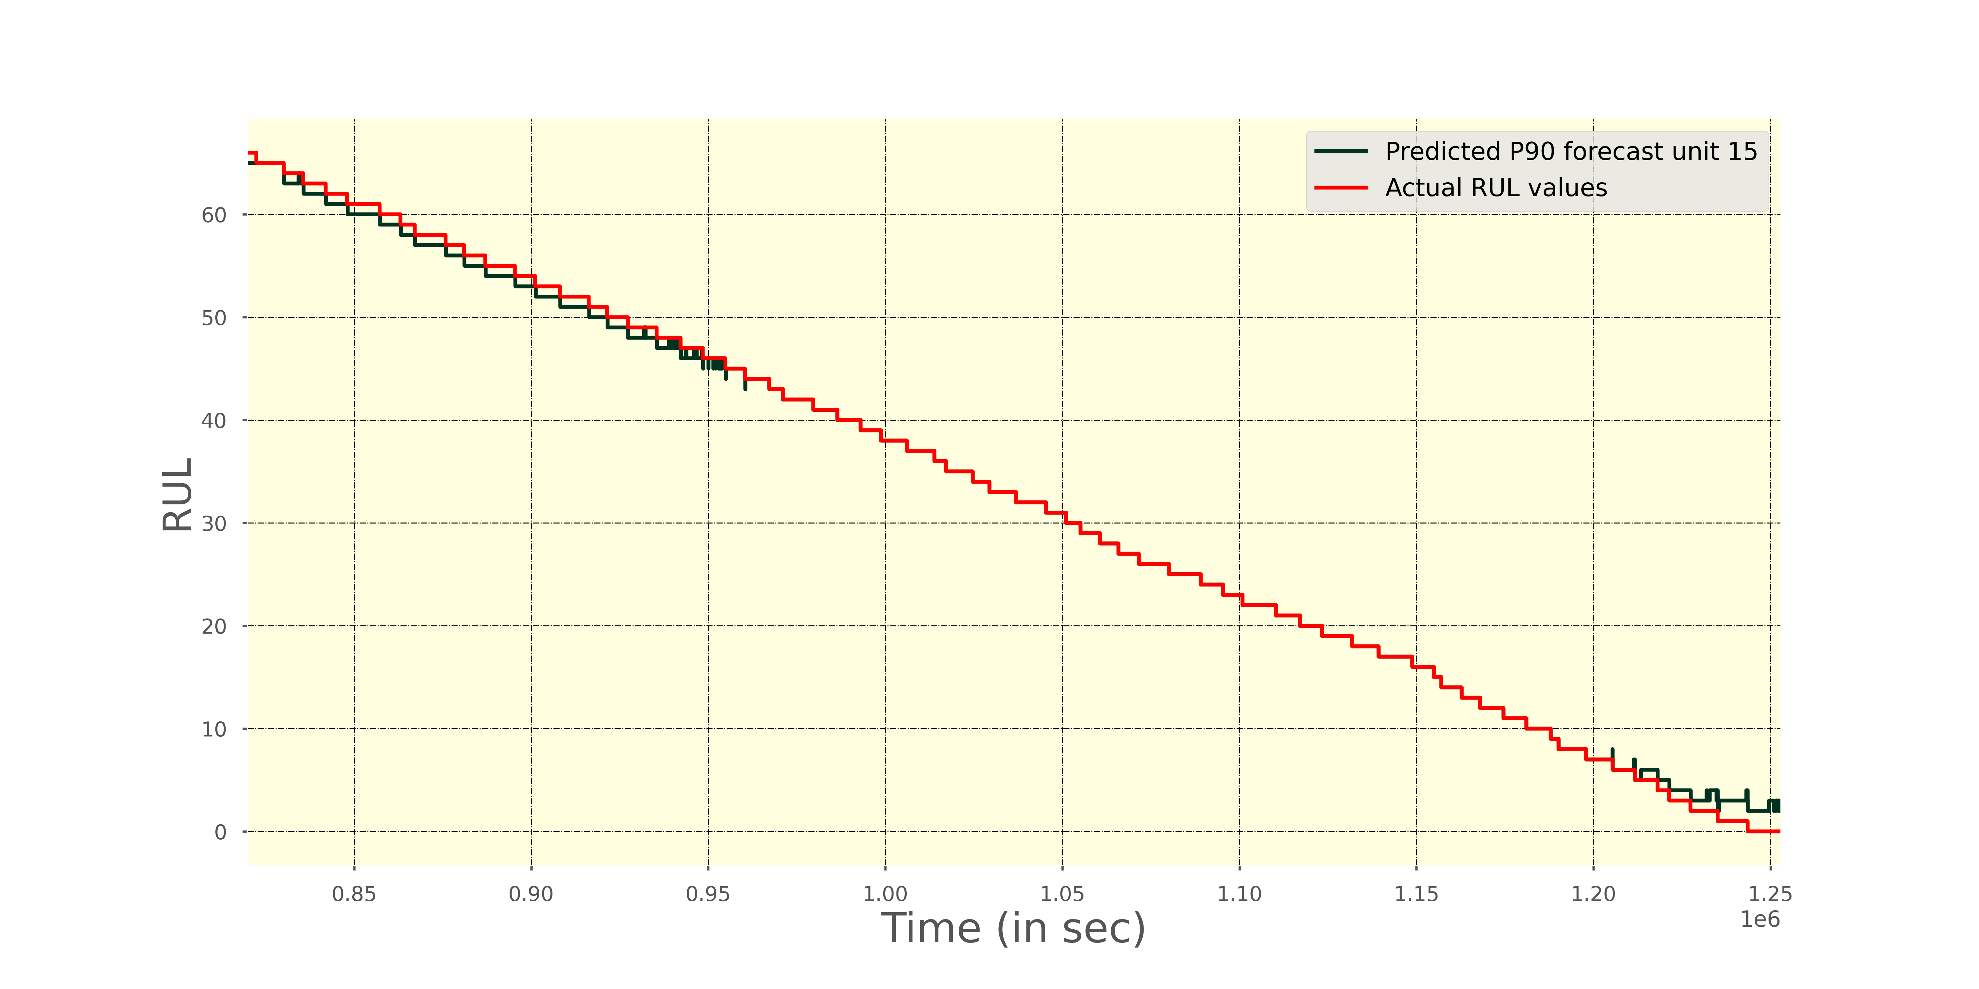

Slide 14
